Slide 1
Baby Care IoT project,
Software Engineering dept.

Slide 2
Team members
Amr Osama Zakzouk
Mohamed Mutaz Atef
Mohamed El-saygh
Mariam El-doweny
Asmaa Ibrahim
Nada Makram
Mahmoud Reda
Mahmoud Maher El-mekawy
Omar El-alfy
Diaa Eldin Magdy
Ahmed Hawam

Slide 3
Agenda
Main problem, Solution
Customer Segment - Who can use our app?
Used components
Board hardware connections
Coding
Demo
Website recap

Slide 4
Agenda
Main problem, Solution
Customer Segment - Who can use our app?
Used components
Board hardware connections
Coding
Demo
Website recap

Slide 5

Main Problem
Busy, working mothers

Slide 6

Solution
Live stream camera

Slide 7

Main Problem
New mothers

Slide 8
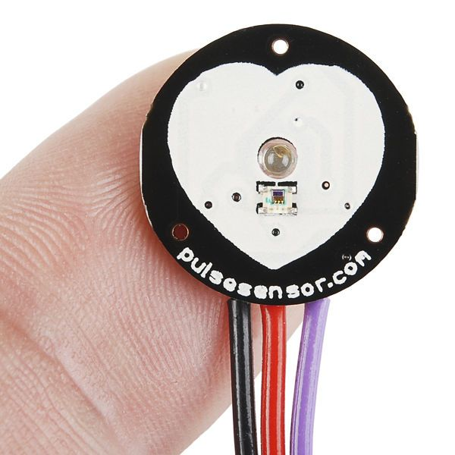
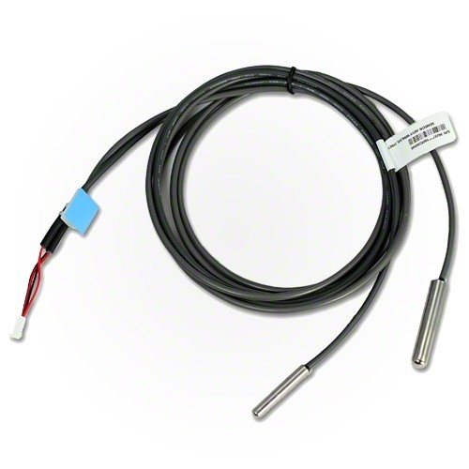
Solution
Monitor heart rate and baby’s temperature

Slide 9

Main Problem
Exhausted mothers

Slide 10

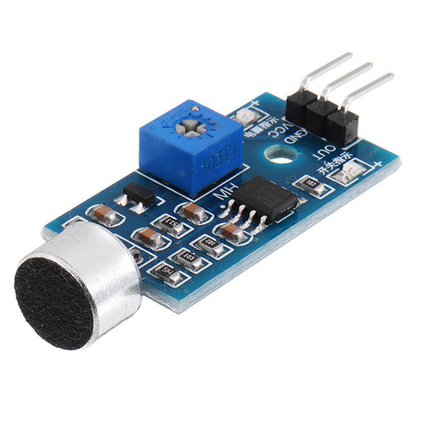
Solution
swinging bed with a mic. sensor

Slide 11
Agenda
Main problem
Customer Segment - Who can use our app?
Used components
Board hardware connections
Coding
Demo
Website recap

Slide 12
Customer Segment - Who can use
our app?
New parents
Far away mothers/parents
Exhausted/working mothers

Slide 13
Agenda
Main problem
Customer Segment - Who can use our app?
Used components
Board hardware connections
Coding
Demo
Website recap

Slide 14
Used components
Breadboard
Wires
3D bed
Arduino uno
ESP8266
Heat sensor
Heart beat sensor
Microphone sensor
Servo motor

Slide 15
Agenda
Main problem
Customer Segment - Who can use our app?
Solution
Used components
Board hardware connections
Coding
Demo
Website recap

Slide 16
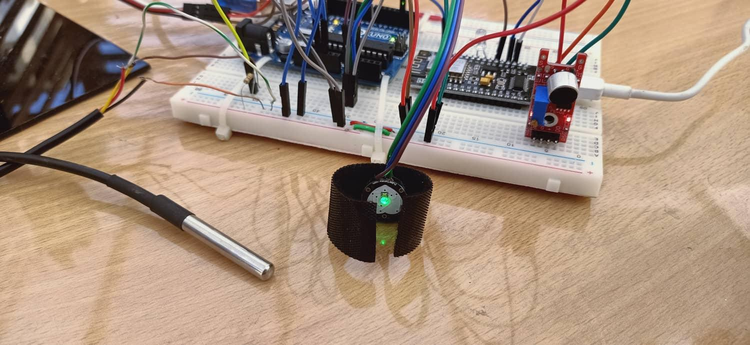
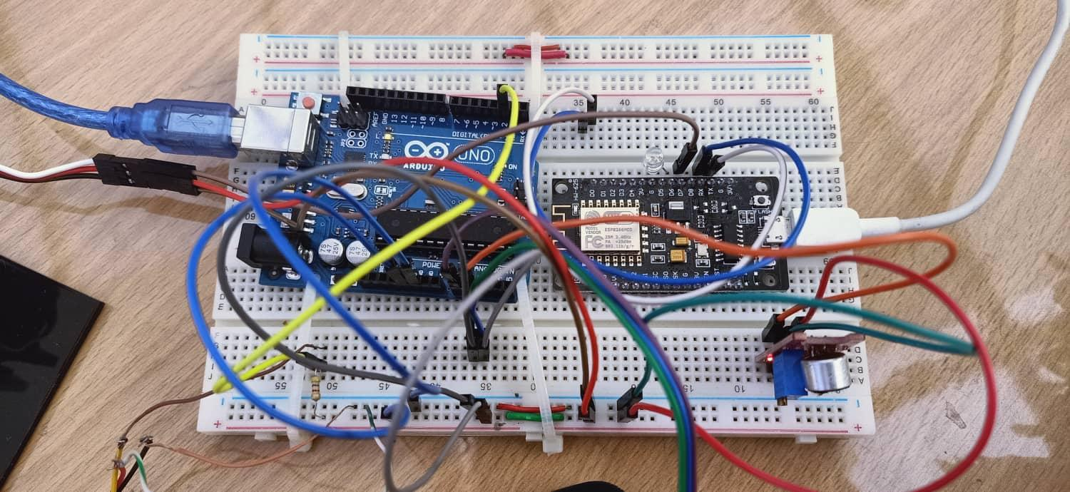
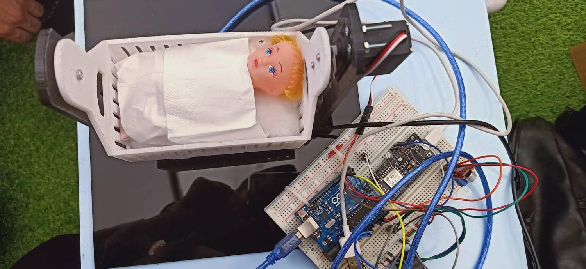
Board hardware connections

Slide 17
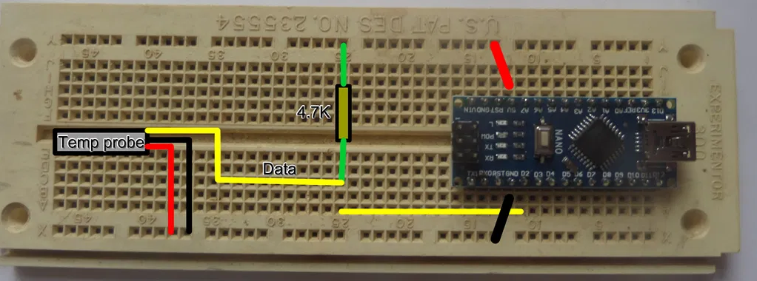
1- temperature sensor wiring diagram

Slide 18
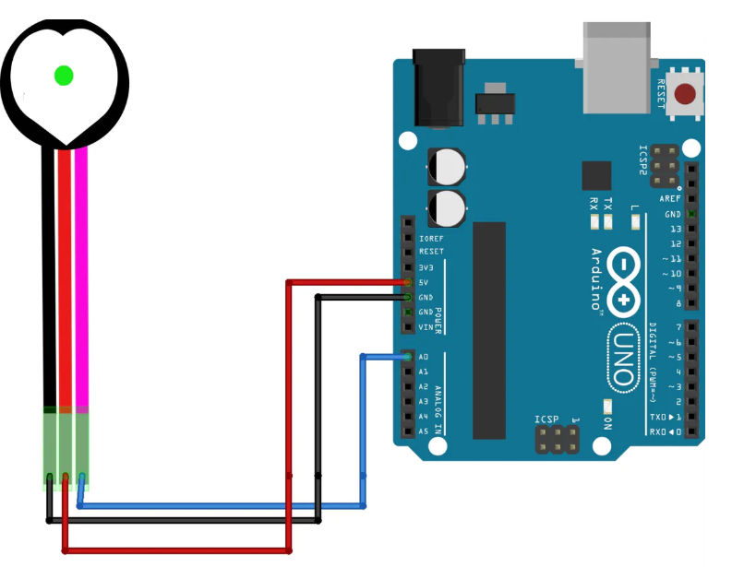
2- heart beat sensor circuit

Slide 19
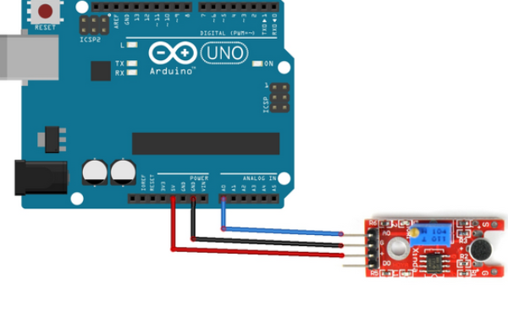
3- Mic. sensor circuit

Slide 20
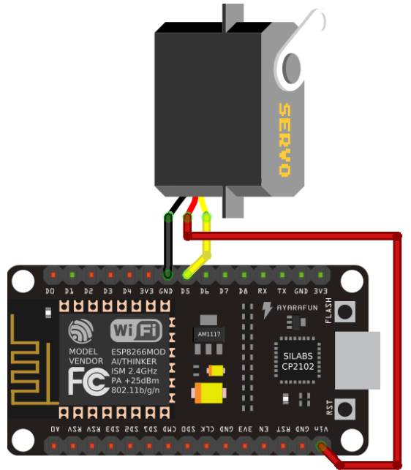
4- servo motor

Slide 21
Agenda
Main problem
Customer Segment - Who can use our app?
Solution
Used components
Board hardware connections
Coding
Demo
Website recap

Slide 22
Coding Agenda
Heart beat code
Temperature sensor code
Motor code
Mic. sensor code
Exchanging data between Arduino and ESP
Website code

Slide 23
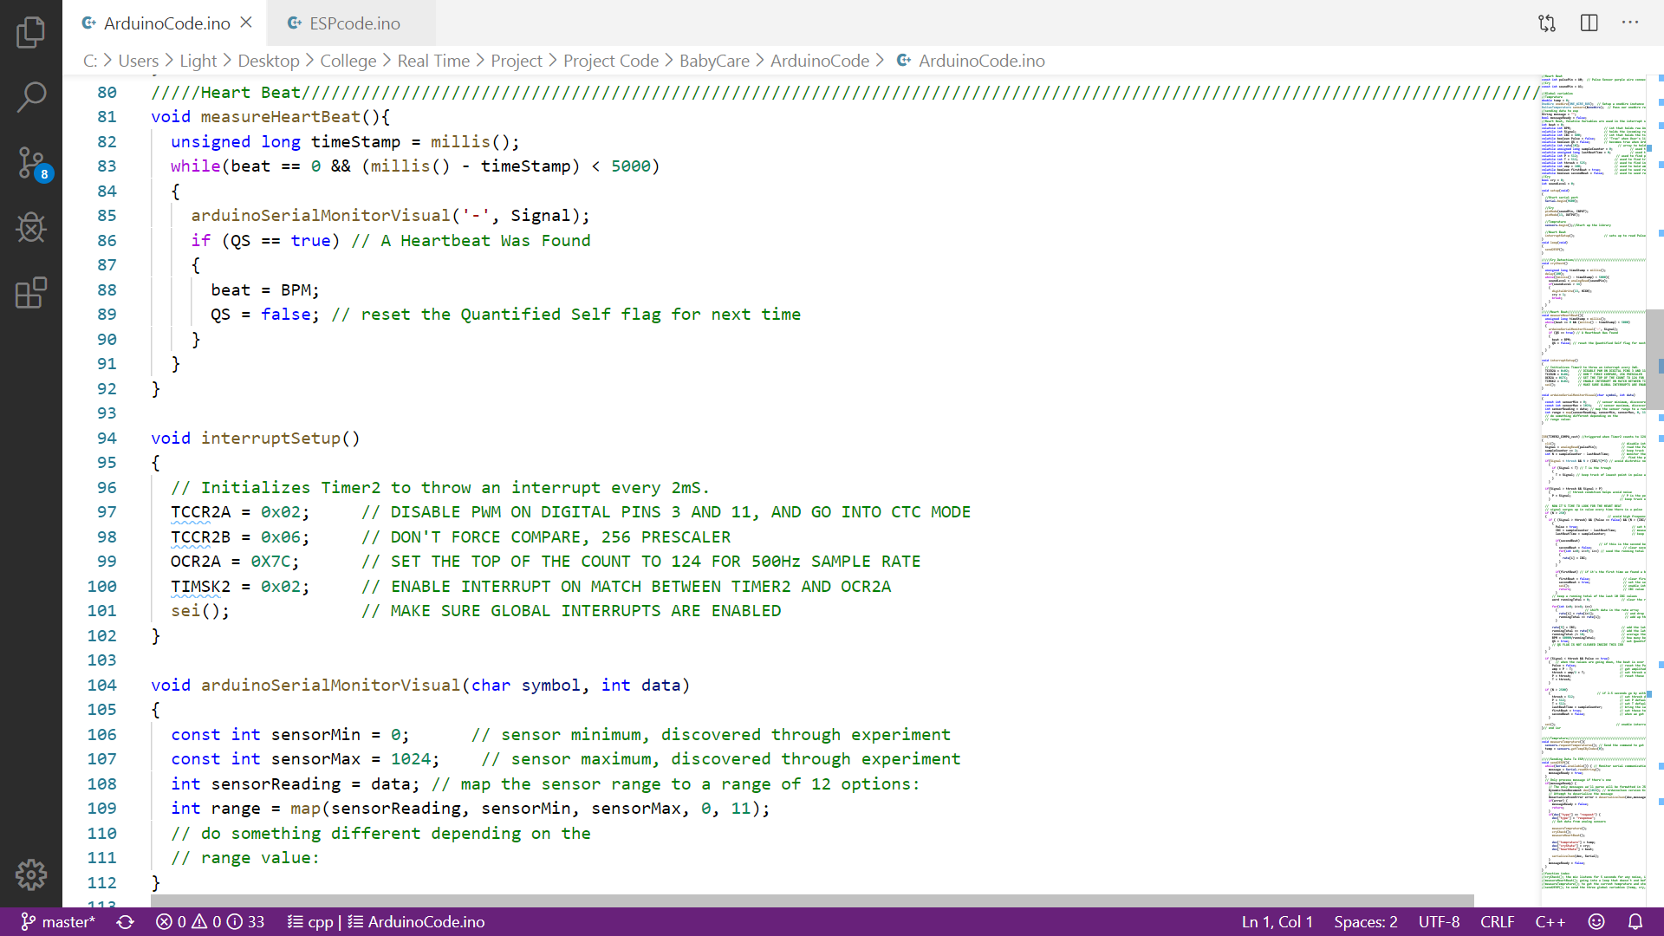

Slide 24
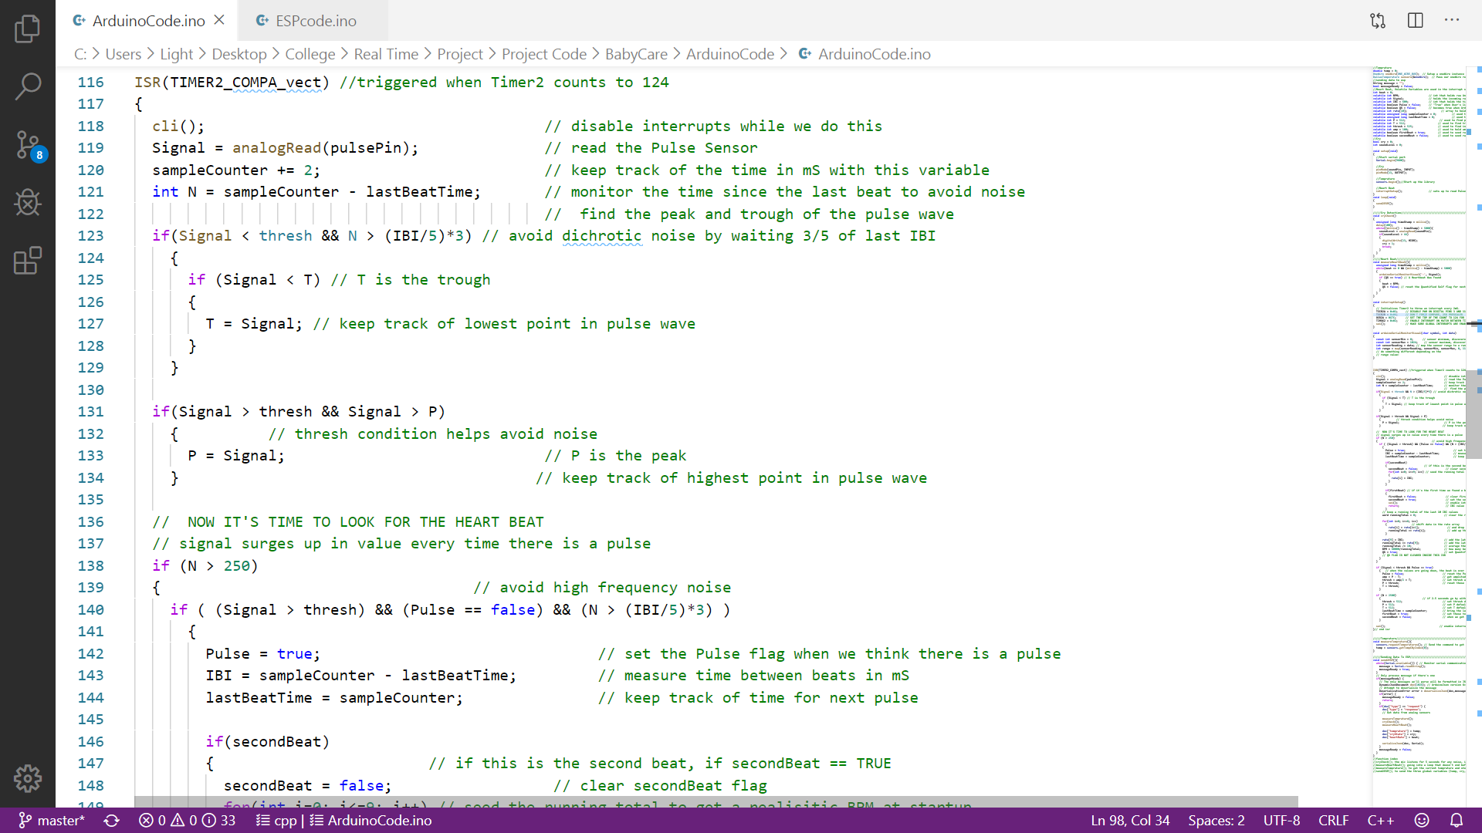

Slide 25
Coding Agenda
Heart beat code
Temperature sensor code
Motor code
Mic. sensor code
Exchanging data between Arduino and ESP
Website code

Slide 26
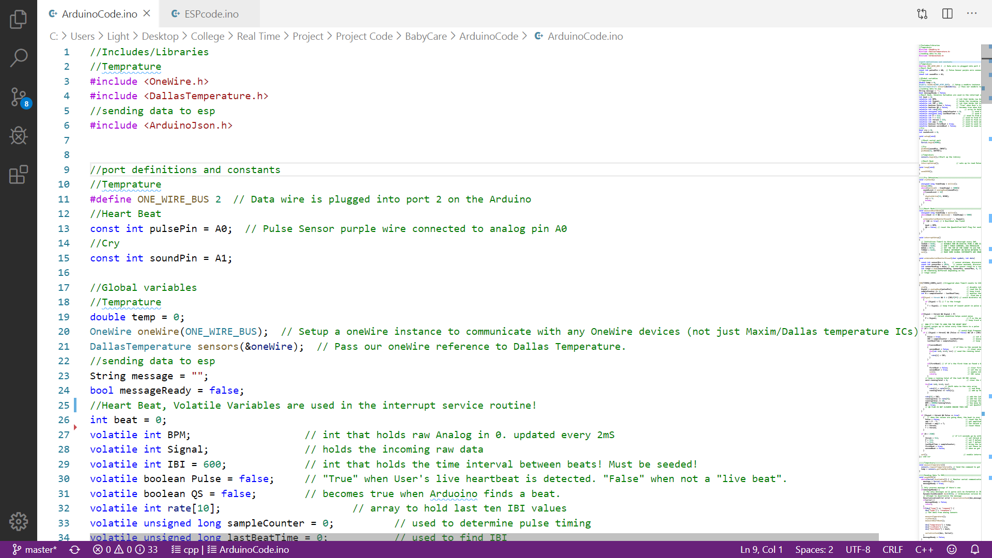
Temperature sensor code

Slide 27
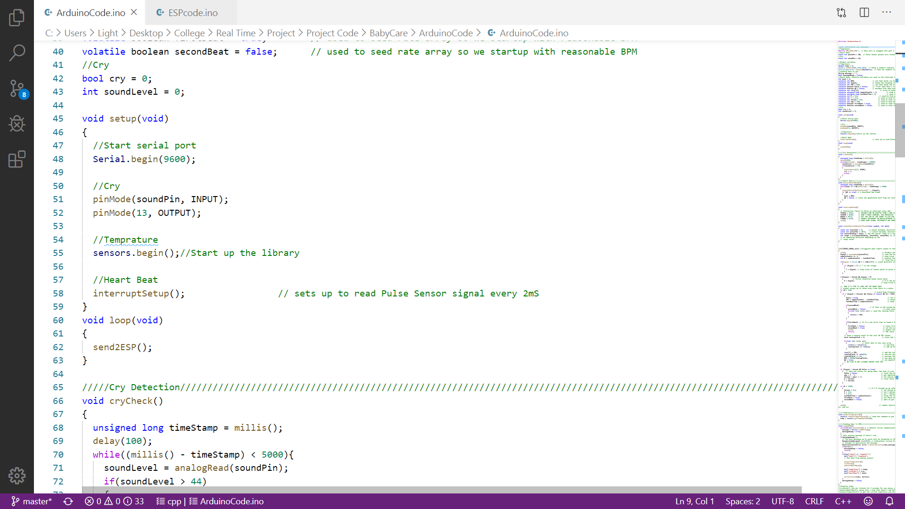

Slide 28
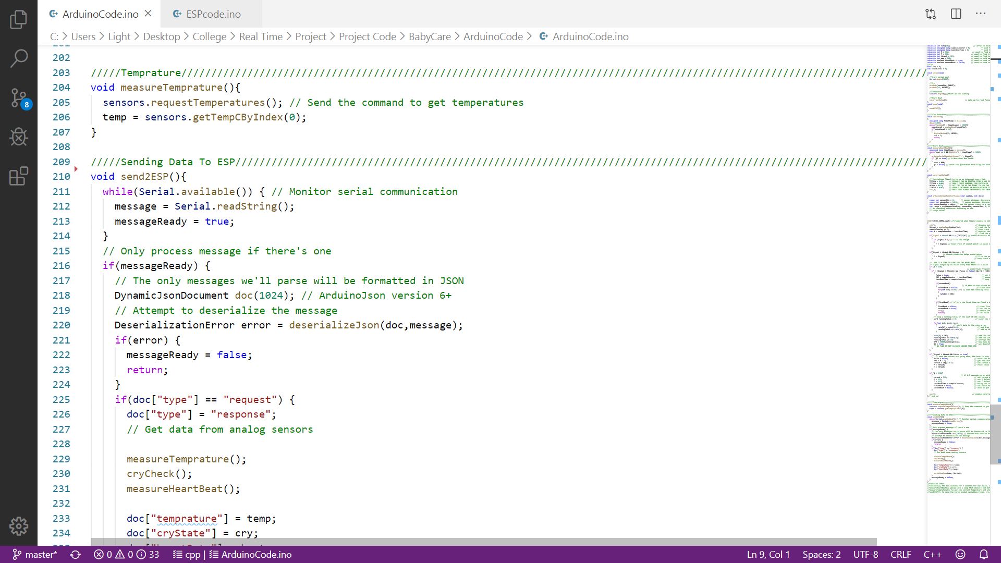

Slide 29
Coding Agenda
Heart beat code
Temperature sensor code
Motor code
Mic. sensor code
Exchanging data between Arduino and ESP
Website code

Slide 30
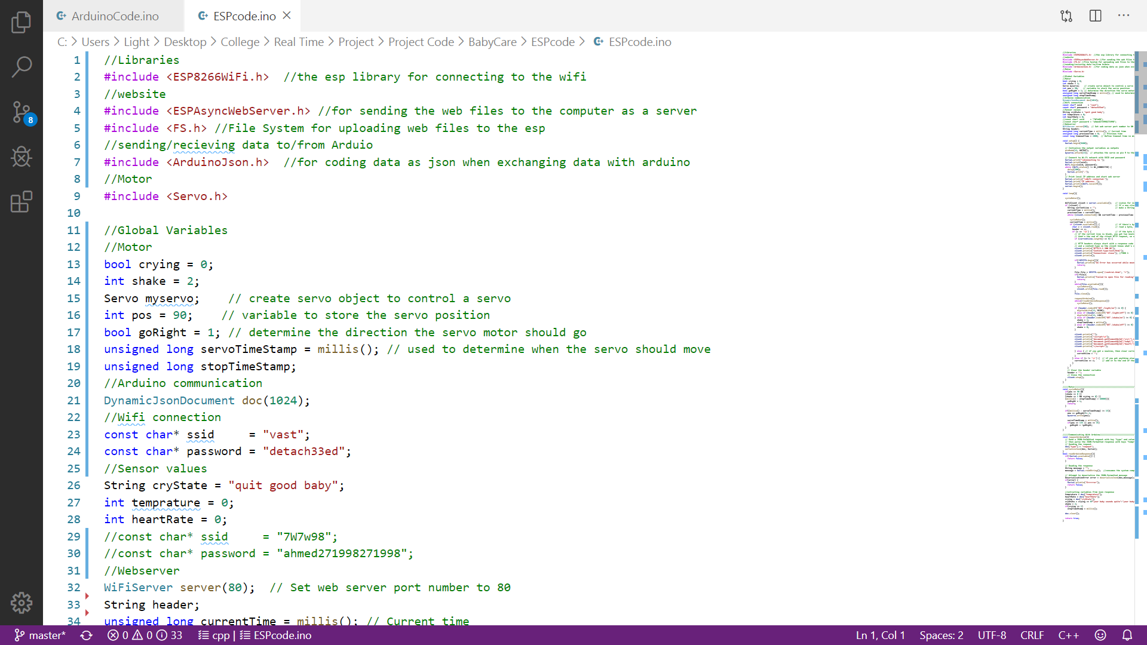
Motor code

Slide 31
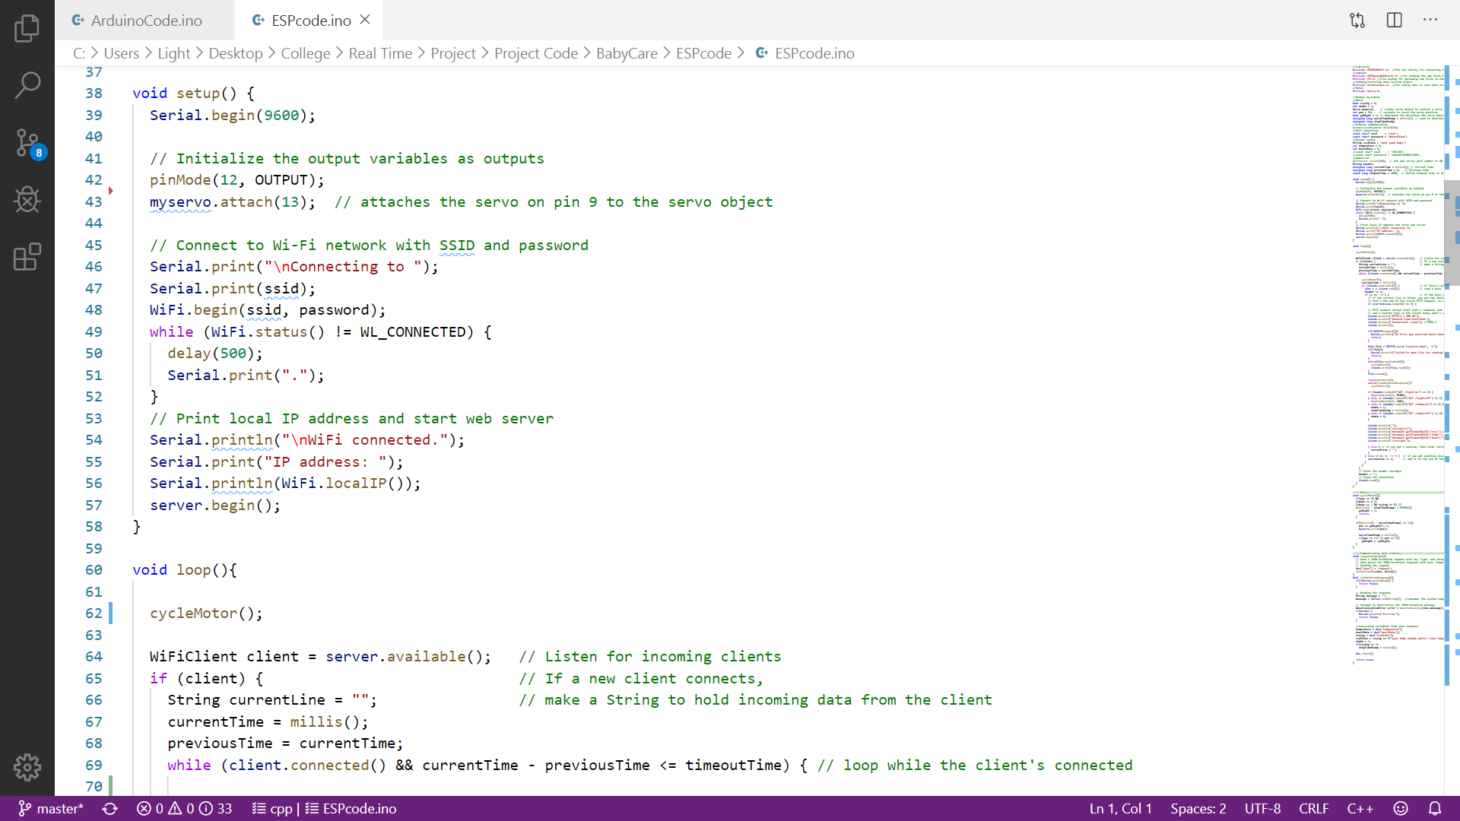

Slide 32
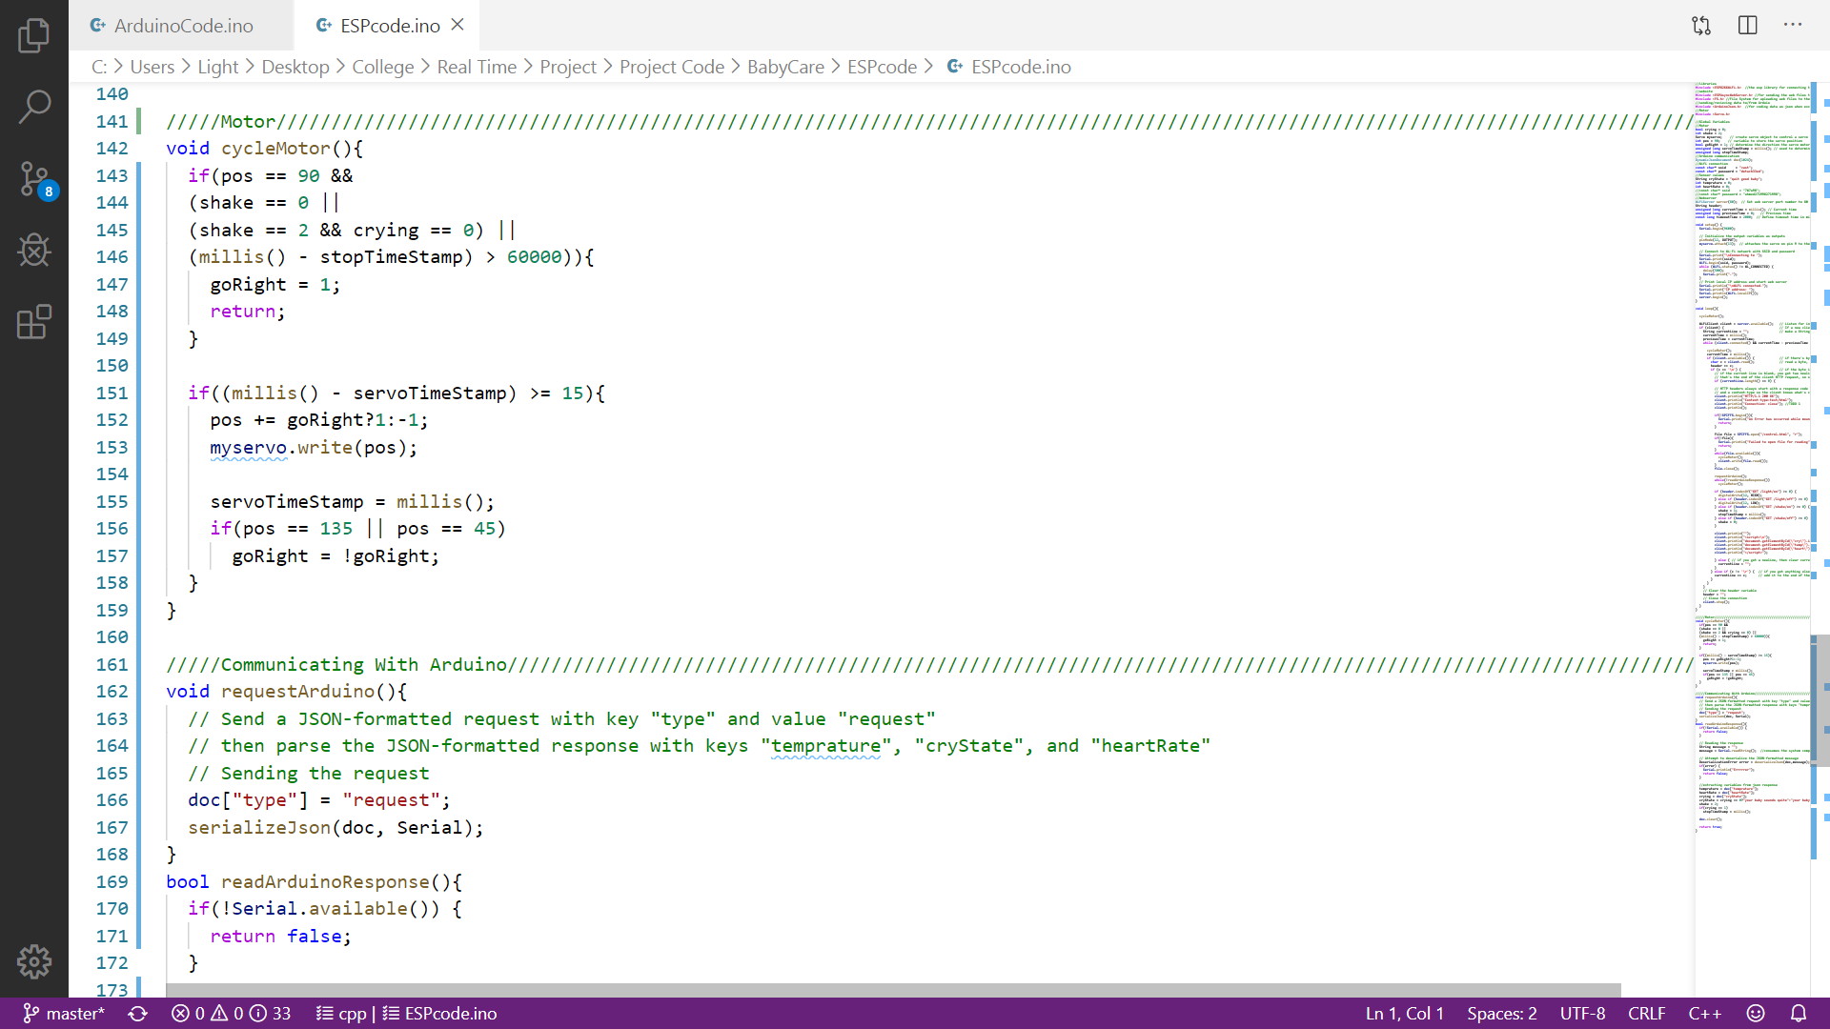

Slide 33
Coding Agenda
Heart beat code
Temperature sensor code
Motor code
Mic. sensor code
Exchanging data between Arduino and ESP
Website code

Slide 34
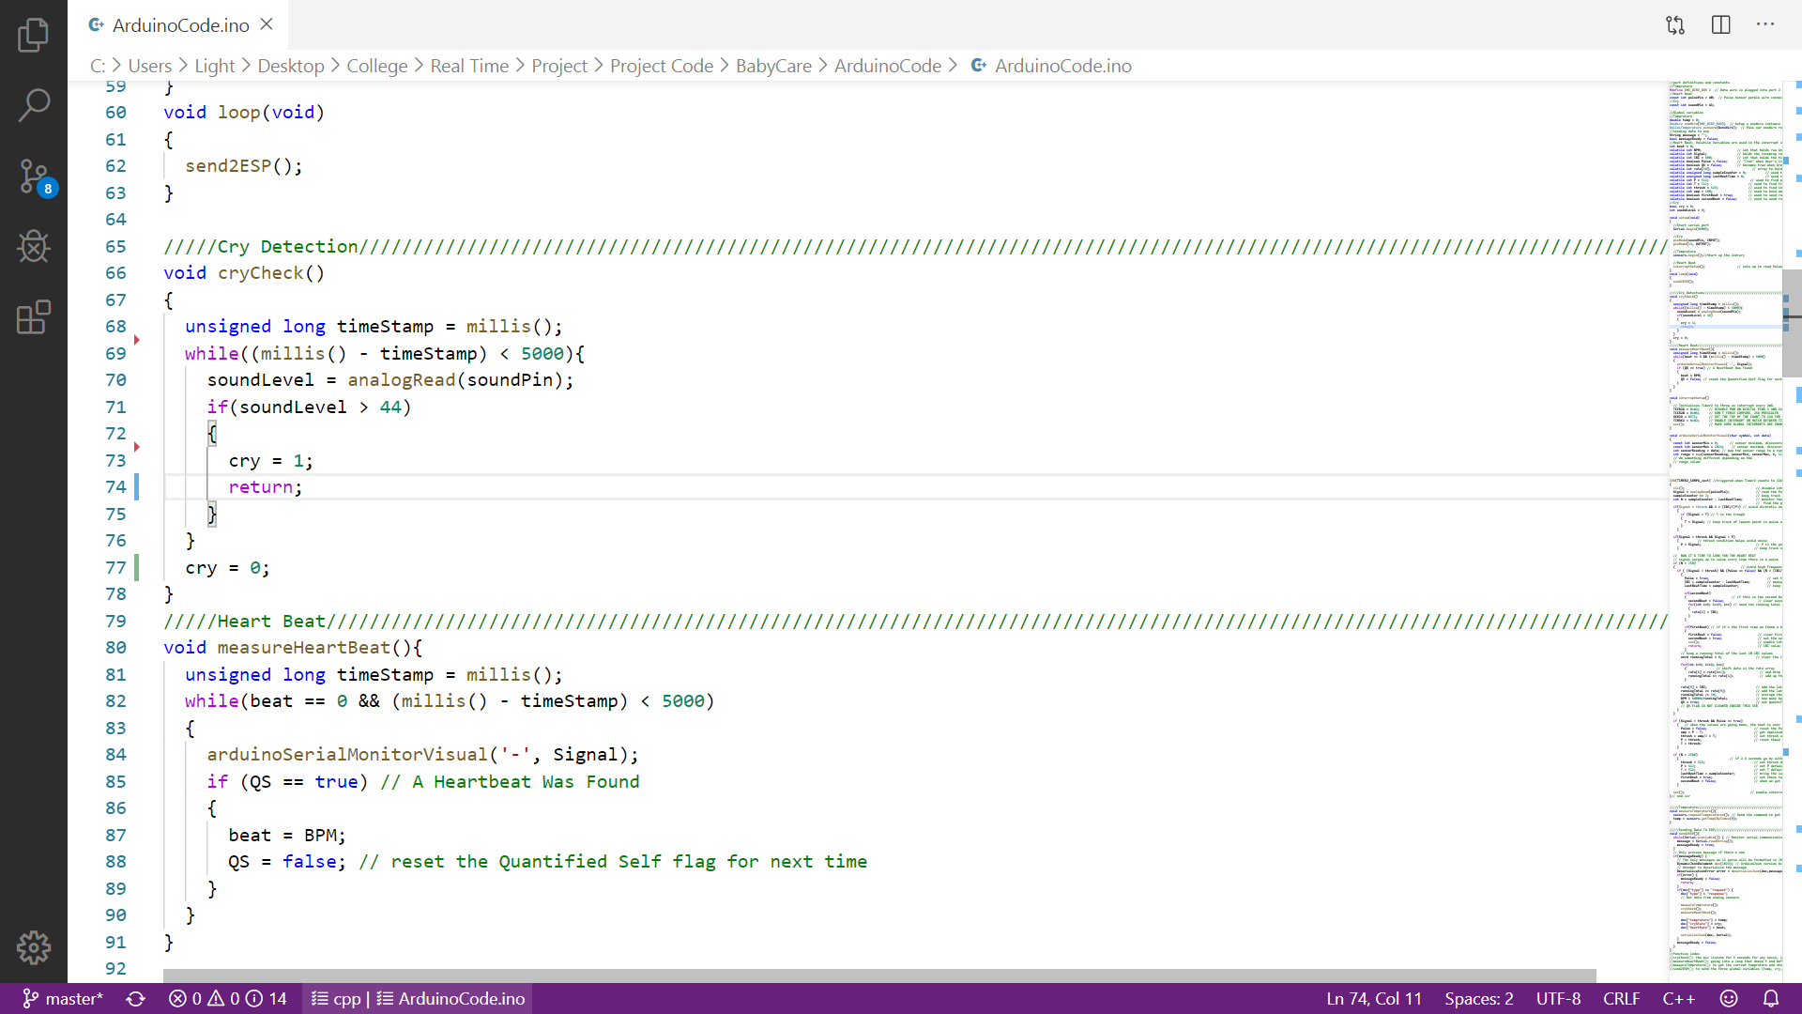
Mic. sensor code

Slide 35
Coding Agenda
Heart beat code
Temperature sensor code
Motor code
Mic. sensor code
Exchanging data between Arduino and ESP
Website code

Slide 36
Transferring Data from arduino to website

Slide 37
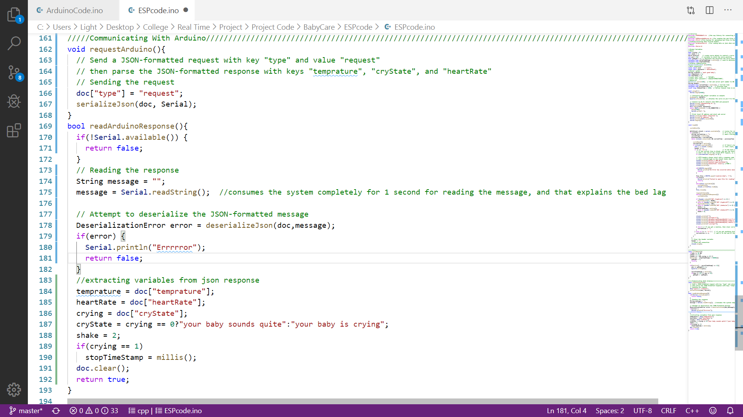

Slide 38
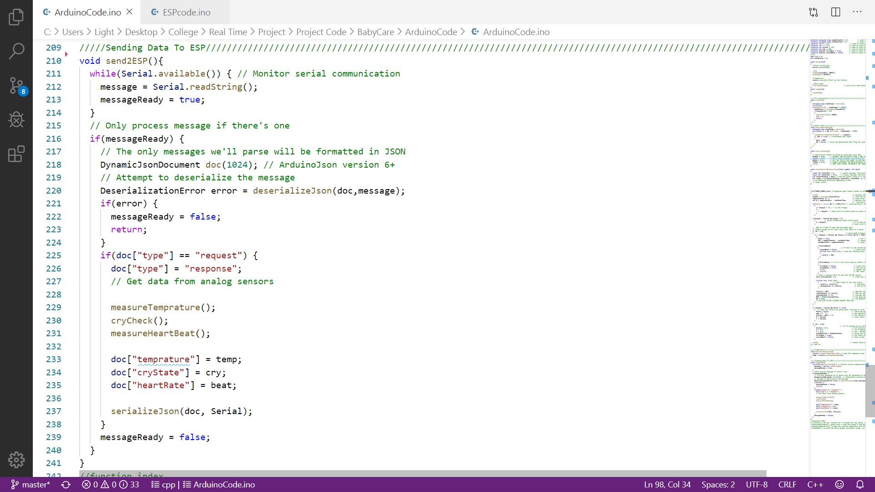

Slide 40
Coding Agenda
Heart beat code
Temperature sensor code
Motor code
Mic. sensor code
Exchanging data between Arduino and ESP
Website code

Slide 41
Website code

Slide 42
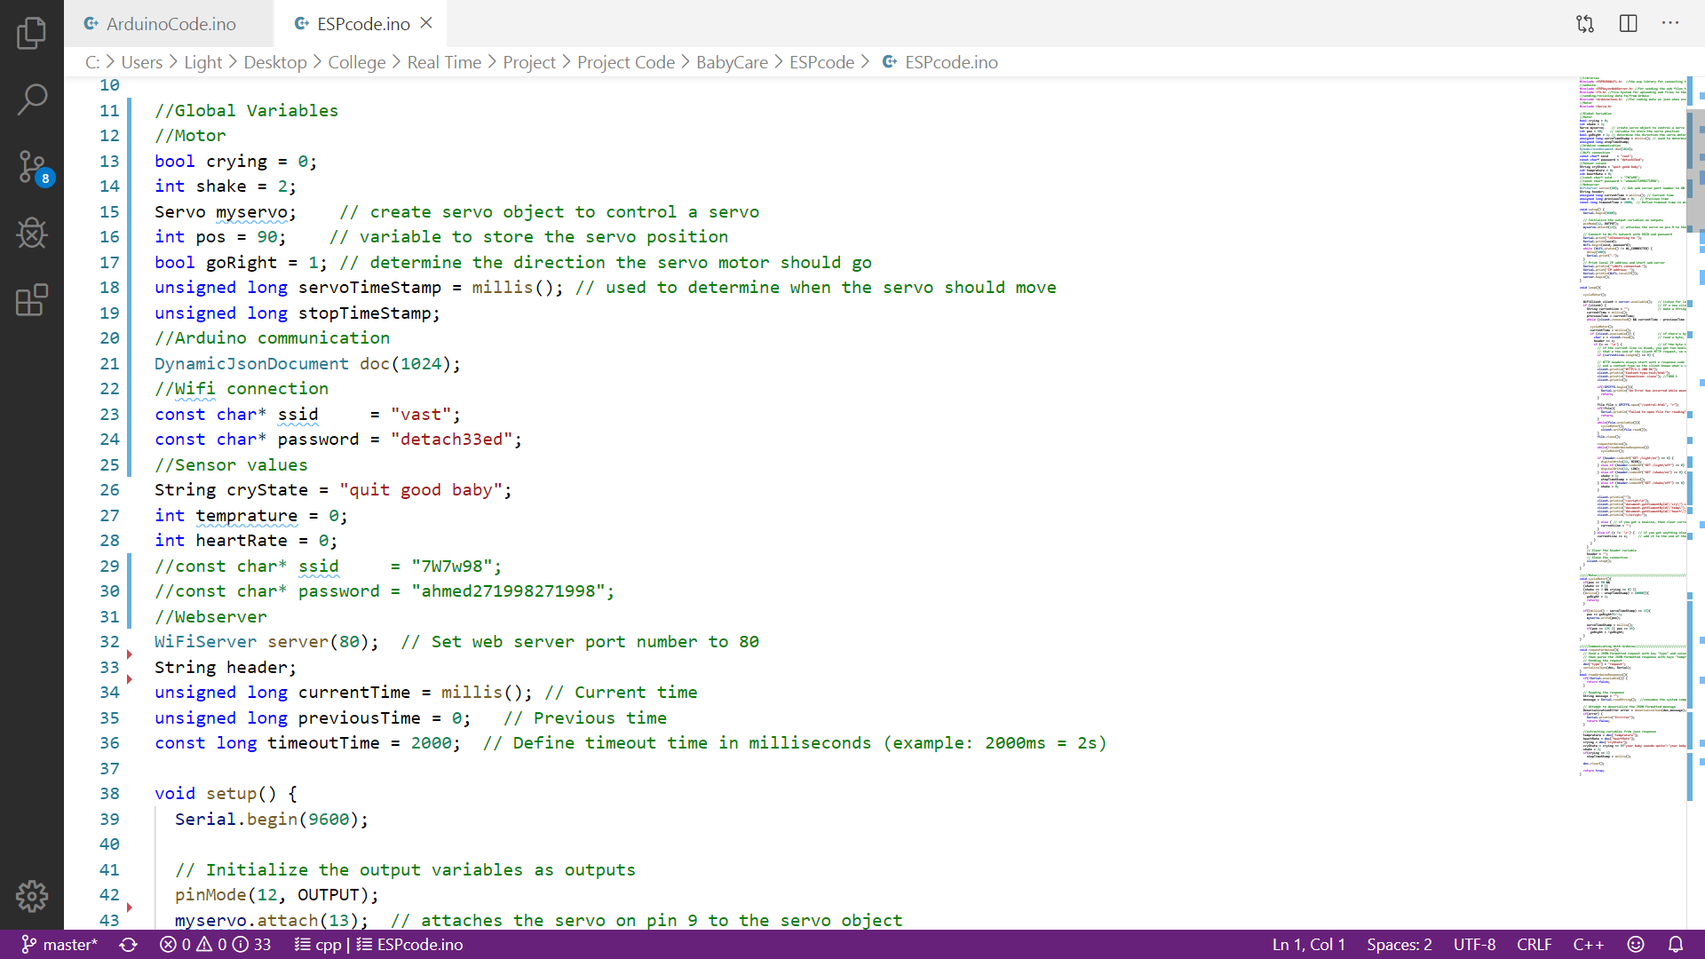

Slide 44
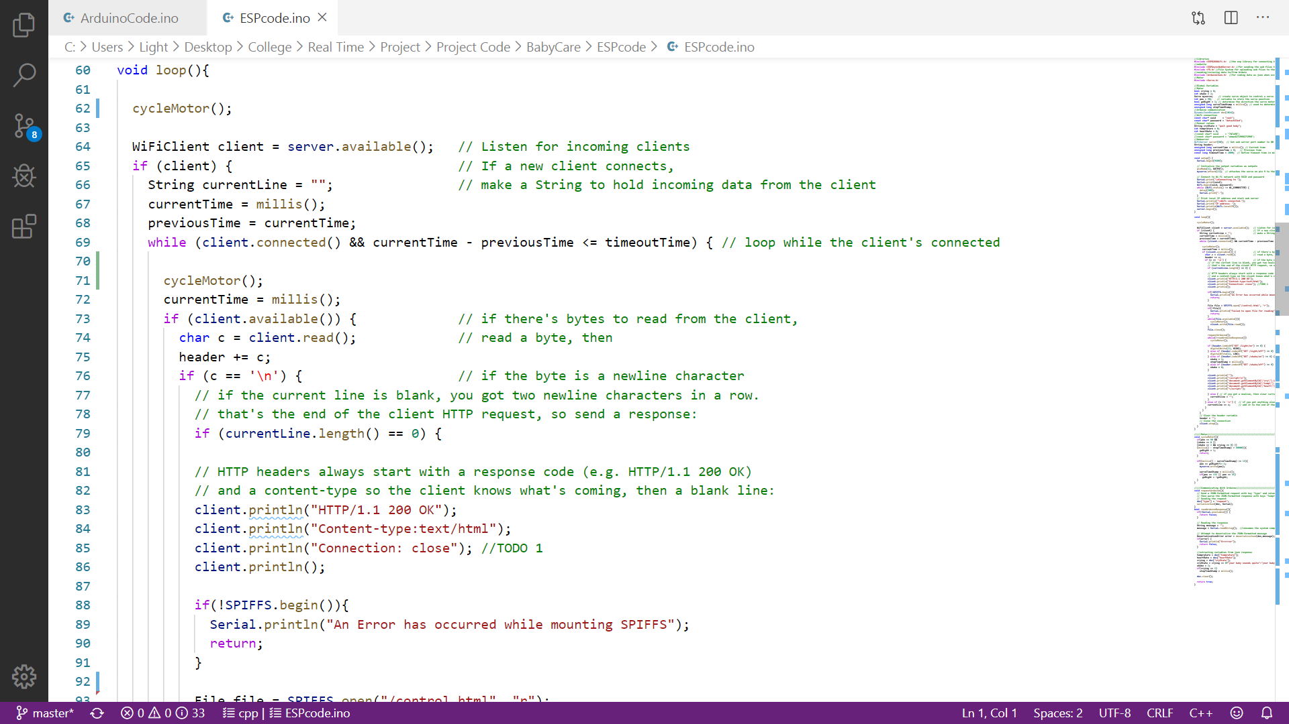

Slide 45
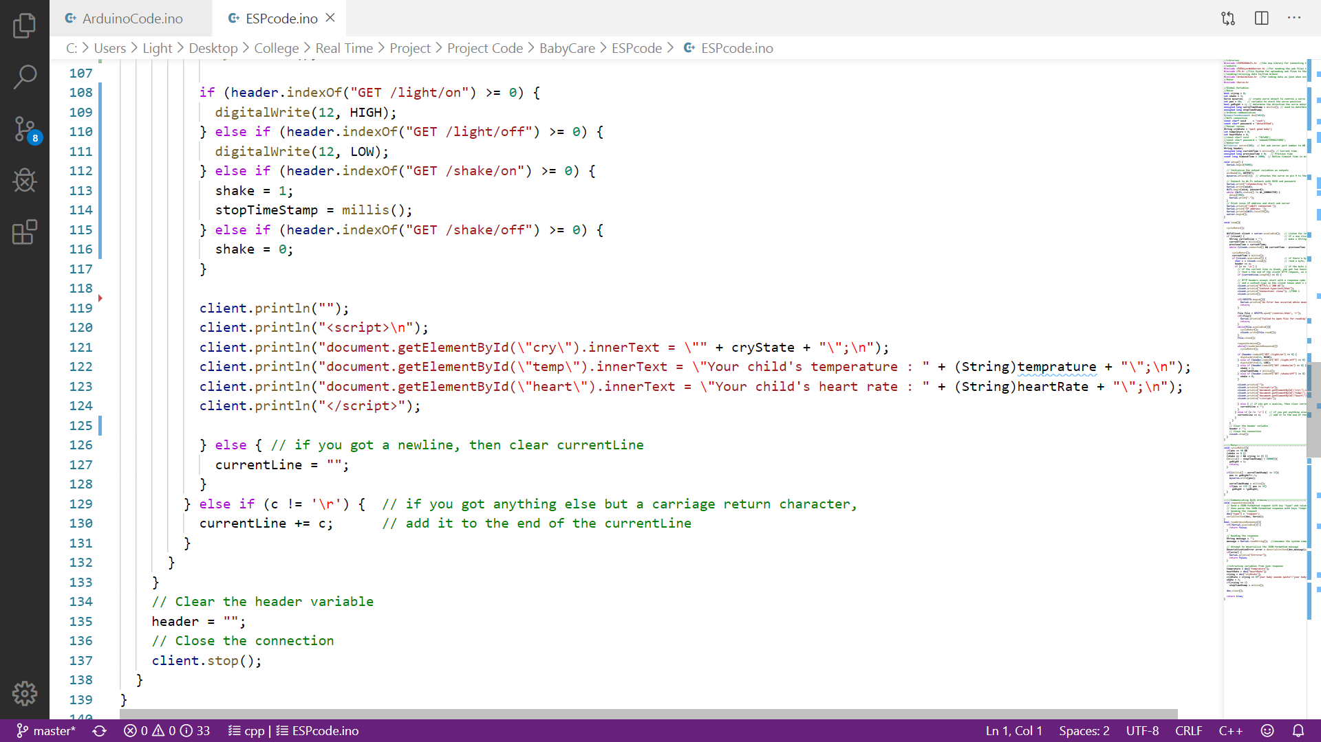

Slide 46
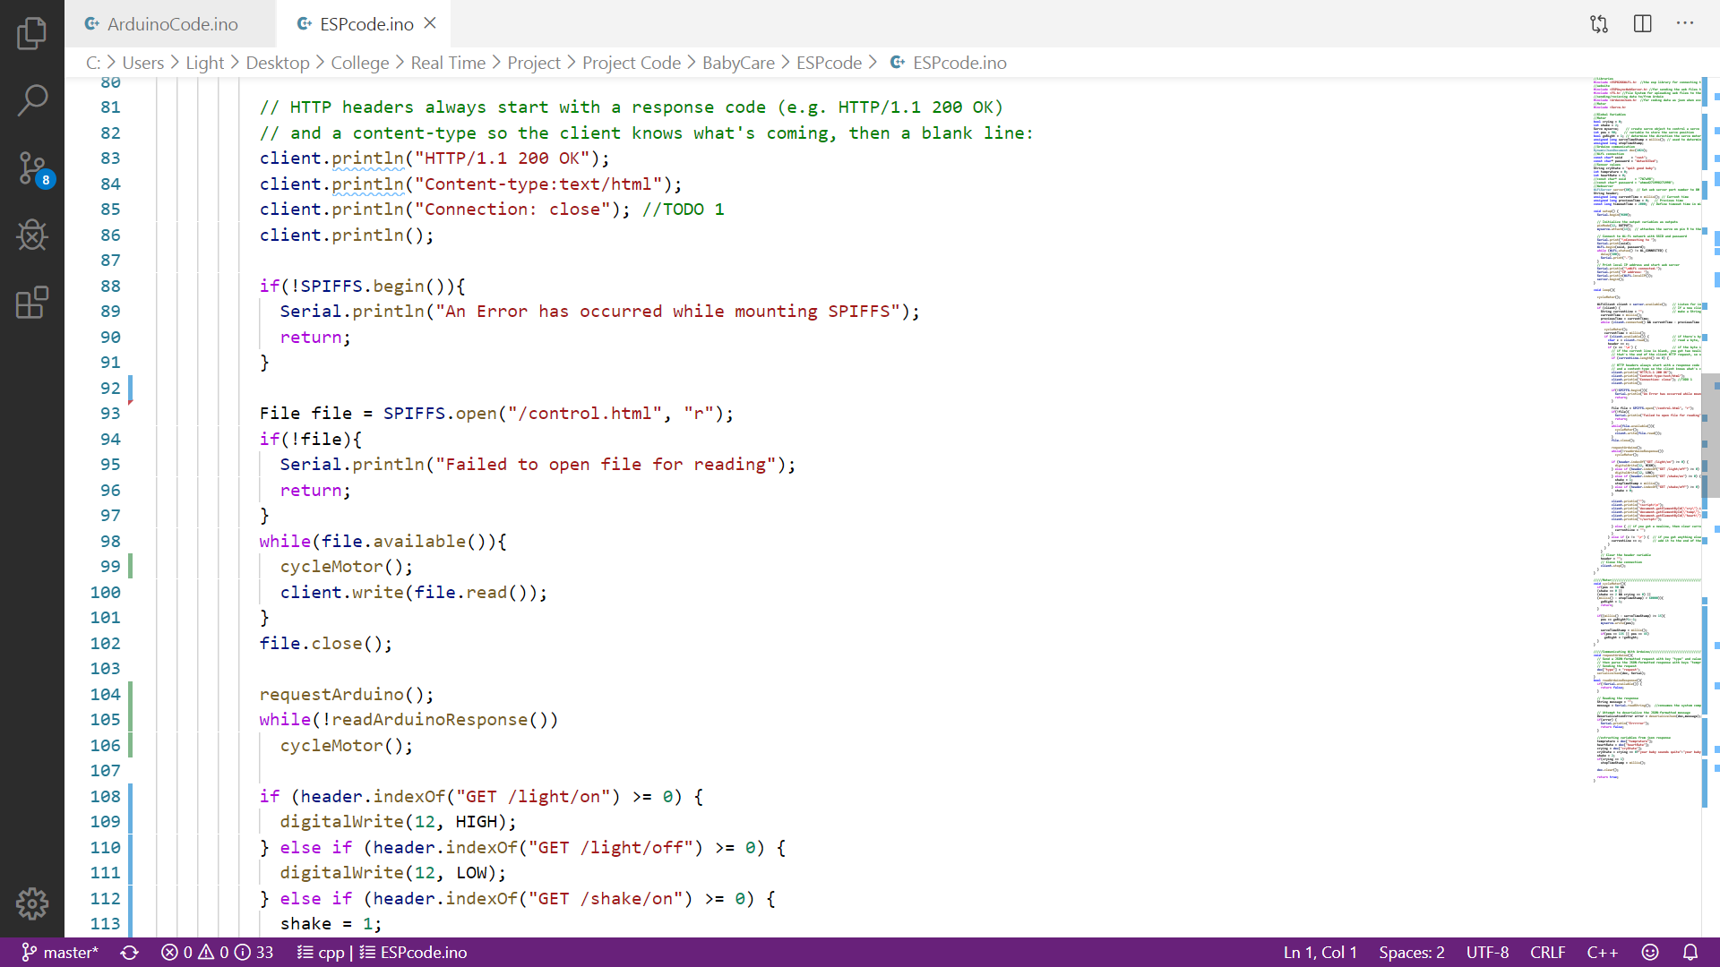

Slide 47
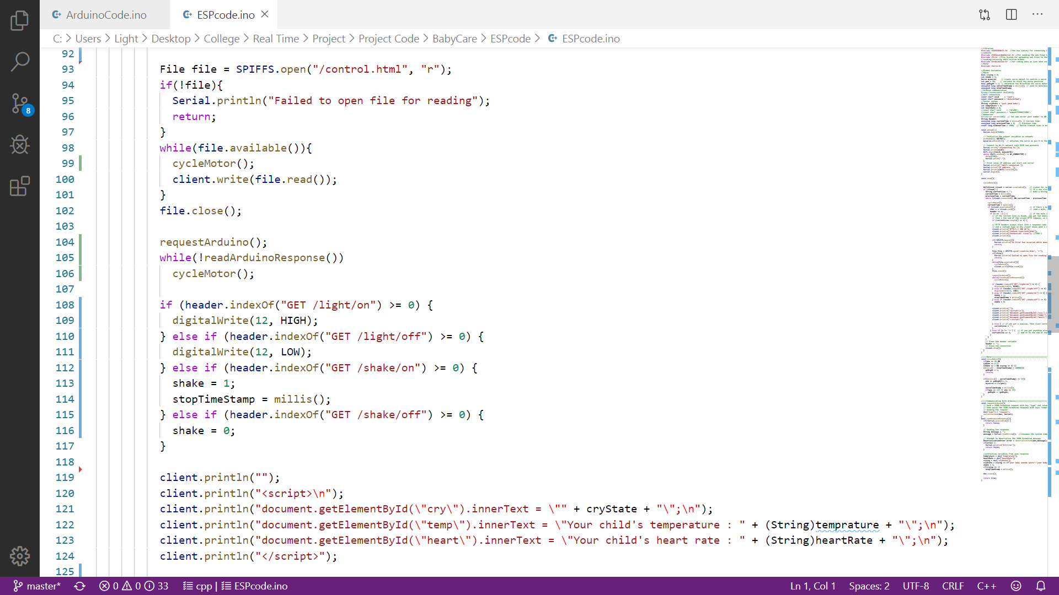

Slide 48
Agenda
Main problem
Customer Segment - Who can use our app?
Solution
Used components
Board hardware connections
Coding
Demo
Website recap

Slide 49
Demo

Slide 50
Agenda
Main problem
Customer Segment - Who can use our app?
Solution
Used components
Board hardware connections
Coding
Demo
Website recap

Slide 51
Website recap

Slide 52
Thank you

